Slide 1


Slide 2

Technology 1: Thermal Imaging

Slide 3

FAILED: THERMAL IMAGING

Slide 4

Technology 2: Camera Robots

Slide 5
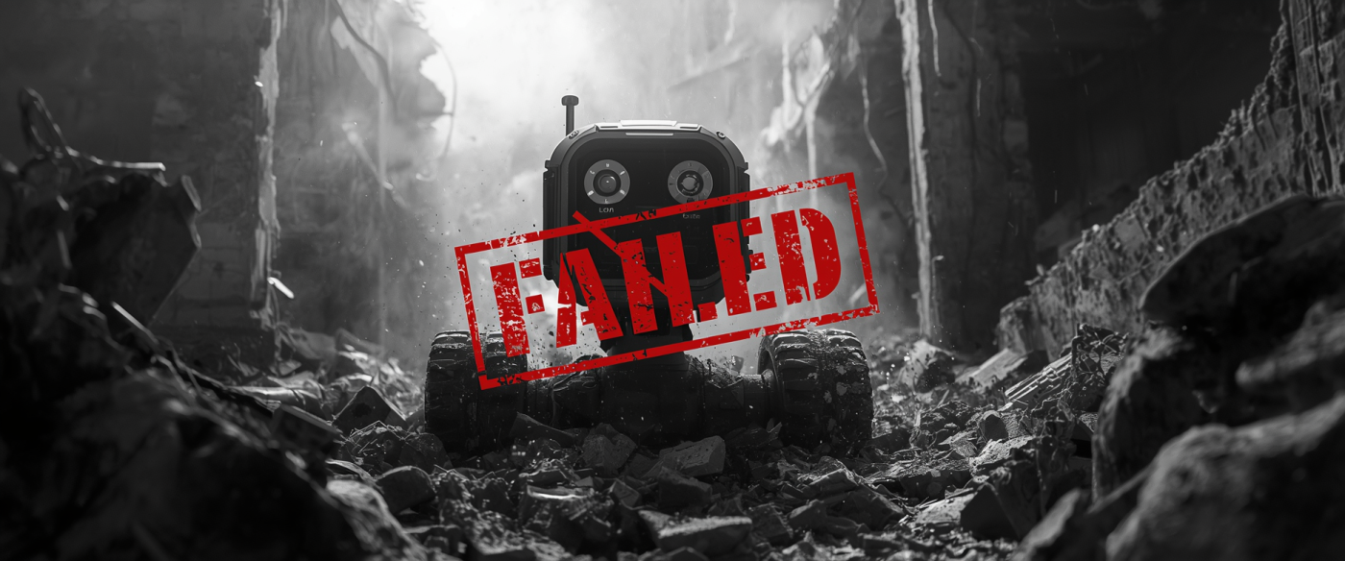
FAILED CAMERA ROBOTS

Slide 6

Technology 3: Acoustic Microphones

Slide 7

FAILED: ACOUSTIC MICROPHONES

Slide 8


ZENIQ
AETHER MK-1
Ambient Edge-Computing Topology For Human Emergency Rescue
PRESENTED BY
Pranav G & Team

Slide 9
Table of Contents
01 Introduction
02 Abstract
03 Proposed System
04 Hardware and Software Configuration
05 Circuit Architecture
06 Software and ML Pipeline
07 Module Description
08 Pros and Cons
09 Future Roadmap AETHER MK-2
10 Impact and Vision

Slide 10

Introduction: The Critical 72-Hour Window
IMPORTANCE OF TIMELY RESCUE IN DISASTERS
Structural collapses create a critical 72-hour survival window for trapped victims. Traditional technologies often fail when needed most, highlighting the urgent need for innovative solutions like AETHER.

Slide 11
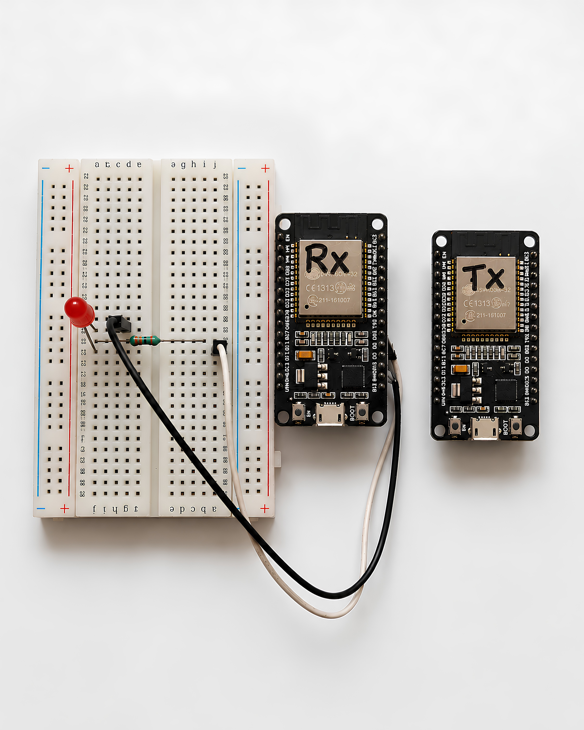
AETHER MK-1: Innovative Radar Technology
REVOLUTIONIZING NON-INVASIVE HUMAN DETECTION
AETHER MK-1 utilizes standard 2.4GHz Wi-Fi and TinyML to detect human movement in debris, providing critical information during rescue operations with zero cloud dependency and low cost.

Slide 12
Proposed System
Advantages of AETHER MK-1
  2.4GHz RF waves penetrate walls and debris without line of sight
  Detects passive movement, breathing, and tremors even if the victim is unconscious
  Ultra-low cost, under Rs 1000 per node, hundreds deployable
  Zero infrastructure dependency; no cellular or internet needed
  Immediate binary proof of life: Dead Rubble vs Trapped Survivor

Slide 13
Hardware and Software Overview
HARDWARE COMPONENTS
SOFTWARE STACK
POWER SUPPLY
The system utilizes two DOIT ESP32 DevKit V1 microcontrollers, a red alert LED, a resistor, and a solderless breadboard, ensuring a cost-effective build under Rs 1000.
Leveraging Edge Impulse for TinyML training, the software stack includes Arduino IDE for embedded inference and Python with VS Code for automated data logging.
Powered by portable 5V power banks, both nodes can operate independently without additional wiring, making the system highly flexible and suitable for disaster zones.

Slide 14
Circuit Architecture: RX Node Wiring
WIRING OVERVIEW
COMPONENT CONNECTIONS
OPERATIONAL PATH
The RX Node uses specific wiring connections, including the GPIO4 D4 pin to communicate with the alert system and control the LED indicator effectively.
The current flows from the GPIO pin through the resistor to the LED, providing a clear visual signal when the AI detects a potential survivor in distress.
Key components such as the 330 Ohm resistor and LED are integrated into the circuit, ensuring that the alert mechanism activates appropriately when a survivor is detected.

Slide 15
Software and ML Pipeline
DATA COLLECTION
MODEL TRAINING
Python scripts log RSSI telemetry every 8 milliseconds, capturing essential data from two datasets: idle conditions in an empty room and active human movement.
Using Edge Impulse, a binary classifier is trained to differentiate between idle and struggle states, optimizing for efficient classification on the ESP32 hardware platform.
ALERT MECHANISM
DEPLOYMENT PROCESS
When struggle confidence exceeds 60 percent, the GPIO4 pin triggers a red LED alarm, providing immediate visual confirmation of potential survivor detection in critical situations.
The Arduino IDE is utilized to flash the optimized inference engine onto the RX ESP32, ensuring it runs continuously to analyze incoming data streams.

Slide 16
Module Description: TX Node, RX Node, and LED Alarm
TX NODE
RX NODE
LED ALARM
The TX node is a DOIT ESP32 DevKit V1 that continuously broadcasts the SSID "AETHER TX MK-1", flooding the debris field with 2.4GHz Wi-Fi radio waves for detection.
The RX node, another ESP32 DevKit V1, runs the TinyML inference algorithm, analyzing RSSI data every 8 milliseconds to classify potential survivors based on movement.
A red LED alarm indicator, activated by the RX node upon detecting a survivor, visually alerts rescuers with a high signal when life is detected in the rubble.

Slide 17
Pros and Cons
PROS
AETHER MK-1 is mass deployable and ultra-low cost (under ₹1000). It penetrates solid barriers without needing a line of sight, successfully detecting human movement and struggling even when victims are unable to speak or call for help.
CONS
The system relies on RSSI volume, meaning victims must produce some movement. Its range is limited to 2 to 3 meters, making proximity essential for effectiveness.

Slide 18
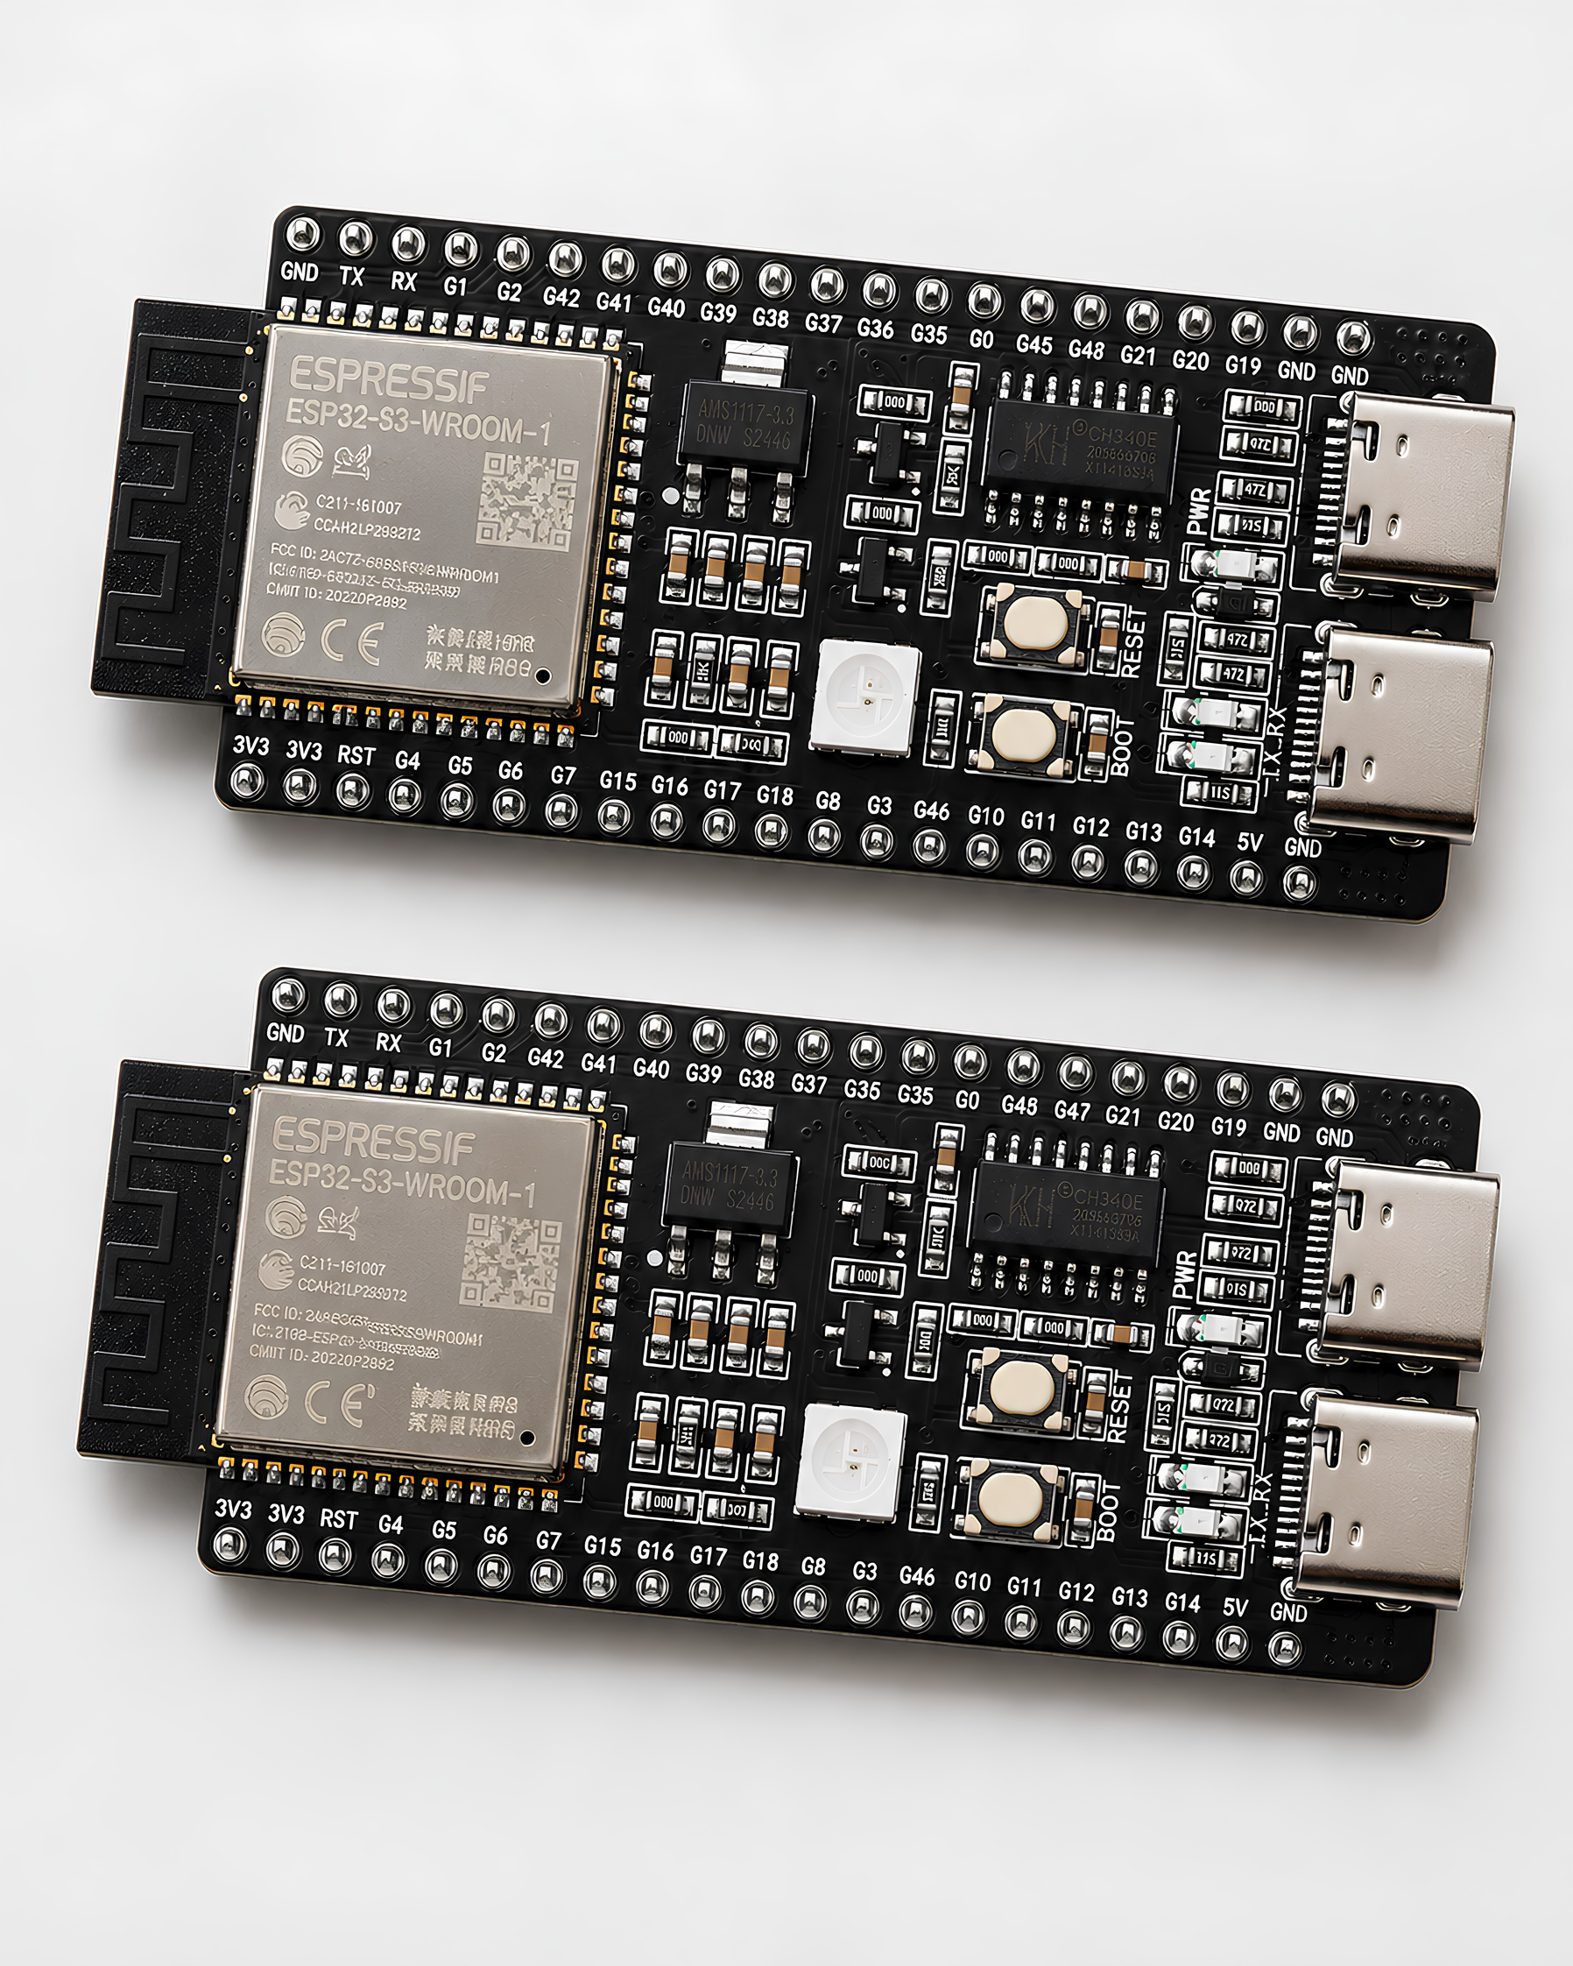
Future Roadmap
ENHANCED DETECTION
Upgrading from RSSI to CSI will enable detection of millimeter-level chest expansion, allowing for effective identification of unconscious survivors by analyzing their breathing rhythm.
ADVANCED HARDWARE
Utilizing dual ESP32-S3 microprocessors will optimize AI performance, enabling faster processing and improved accuracy in detecting trapped individuals in challenging environments.

Slide 19

Thanking You!
GRATEFUL FOR YOUR TIME AND ATTENTION

